Slide 1







BUILDING AND SECURING A SMALL NETWORK
Studio Shodwe
01

Slide 2




Studio Shodwe
MISSION CONTENT
Network Design.
01
Configuration and Implementation
02
Security Implementation and Testing
03
02

Slide 3
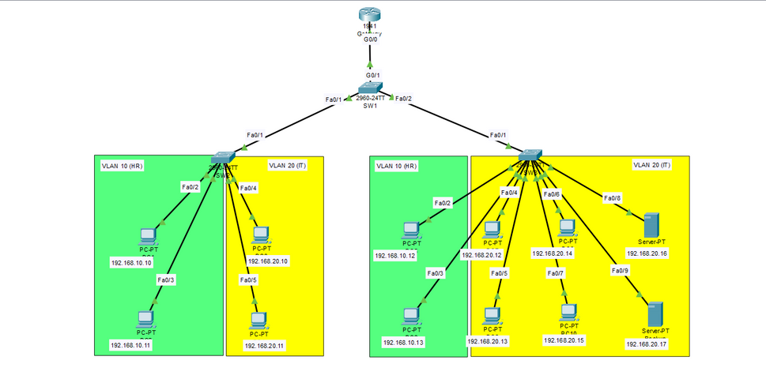
Studio Shodwe
NETWORK DESIGN.
Design the Physical Layout
01
Routers: Connect different network segments.
Switches: Connect multiple devices within the same segment.
A web server: a system that hosts and delivers web pages to users over the internet handling requests via protocols like HTTP/HTTPS.
A backup server: stores copies of data from other systems, providing a safeguard to restore information in case of data loss, corruption, or failure.
03

Slide 4

Studio Shodwe
Segment the Network
IT Department: Connect via switches to a dedicated segment.
Server Segment: Isolate servers in a separate segment for security and performance.
04

Slide 5

Studio Shodwe
02
Configuration Security Implementation and Testing
Implementing Port Security
1. Shutting Down Unused Ports.
Switch(config)# interface range <interface-id>
Switch(config-if)# shutdown
2. Mitigating MAC Address Table Overflow Attacks
Enabling Port Security
Switch(config)# interface <interface-id>
Switch(config-if)# switchport mode access
Switch(config-if)# switchport port-security
05

Slide 6
Studio Shodwe
2. Mitigating MAC Address Table Overflow Attacks (continue)
Setting the max. number of secure MAC address to 1
Switch(config-if)# switchport port-security maximum 1
Configuring the learning process for the MAC address to sticky
Switch(config-if)# switchport port-security mac-address sticky
Setting the Port Security Violation Mode to restrict
Switch(config-if)# switchport port-security violation restrict
06

Slide 7


SECURITY MEASURES
Studio Shodwe
03
Access control:
Inbound and Outbound Rules: Define rules to control traffic based on IP addresses, ports, and protocols.
Access Control Lists (ACLs): Restrict access to sensitive segments.
2.Network Segmentation:
VLANs: Use VLANs to separate different network segments.
Inter-VLAN Routing: Control traffic between VLANs using a Layer 3 switch or router.
3.Implemented features that considers security
Using enable secret instead of enable password for more secure password by using md5 hashing algorithm.
Changing the default native & management VLANs from VLAN 1 to be VLAN 99 (Management) and VLAN 100 (Native).
Using SSH version 2 instead of the legacy version 1.
Using a large modulus space with a 2048 bits when generating the RSA keys for SSH communication encryption.
Setting a password policy that restricts using a password length of min. size of 12 characters when configuring the network devices.
Allowing VTY logins for two minutes if three failed login attempts occur within 60 seconds.
07

Slide 8
SECURITY MEASURES
Studio Shodwe
03
4.Mitigating VLAN Hopping Attacks
Disable DTP (auto trunking) negotiations on non-trunking ports by using the switchport mode access interface configuration command.
Disable unused ports and put them in an unused VLAN.
Manually enable the trunk link on a trunking port by using the switchport mode trunk command.
Disable DTP (auto trunking) negotiations on trunking ports by using the switchport nonegotiate command.
Set the native VLAN to a VLAN other than VLAN 1 by using the switchport trunk native vlan vlan_number command.
08

Slide 9




Best Practices for Network Security
Strong Password Policies: Encourage the use of complex, unique passwords.
Regular Software Updates: Ensure that all software, firmware, and devices are up-to-date.
Network Monitoring: Continuous monitoring of traffic to detect unusual activities.
Backup and Recovery Plan: Regularly backup critical data and have a disaster recovery strategy.
09

